Slide 1
GADGET MART
A ECOMMERCE WEBSITE
-PARTEEK 2010991966

Slide 2
CONTENTS
01
02
03
04
INTRO
PURPOSE
OF BUSINESS
PAGES INCLUDED
LANGUAGES
INCLUDED

Slide 3
INTRO
01

Slide 4
E-COMMERCE
A
B
E-commerce is fast gaining ground as an accepted and used business paradigm.
More and more business houses are implementing web sites providing functionality for performing commercial transactions over the web
D
C
An online store is a virtual store on the Internet where customers can browse the catalog and select products of interest
It is reasonable to say that the process of shopping on the web is becoming commonplace.

Slide 5
AGENDA OF BUSINESS
02

Slide 6
DEMAND
OFFERS
RETURN POLICY
VARITIES
Fulfill the increase in
demand of electronic
items due to increasing
population.
Giving best offers
with respect to
offline stores
Customer can replace or return item till 30 days
Customer will have
more buy options than offline store

Slide 7
PAGES INCLUDED IN WEBSITE
03

Slide 8
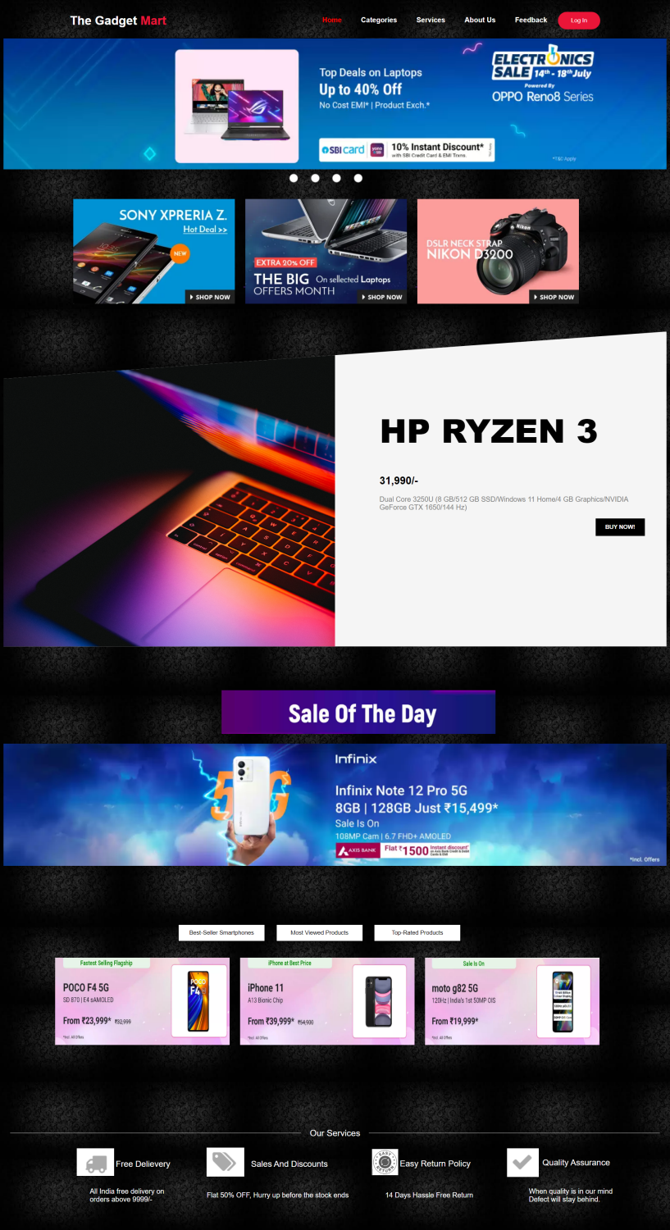
Home Page

Slide 9
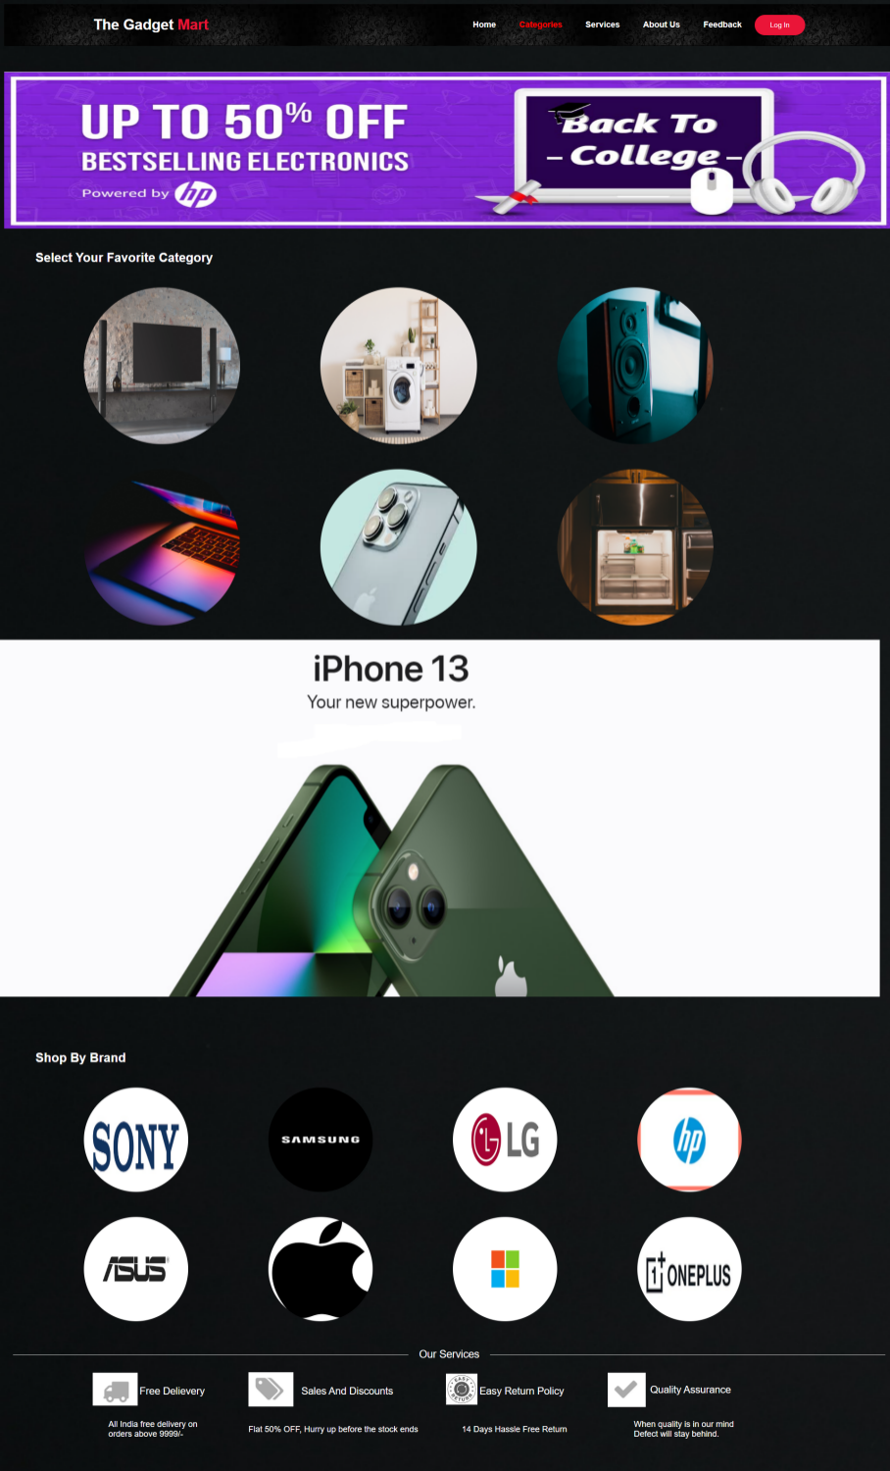
Category Page

Slide 10
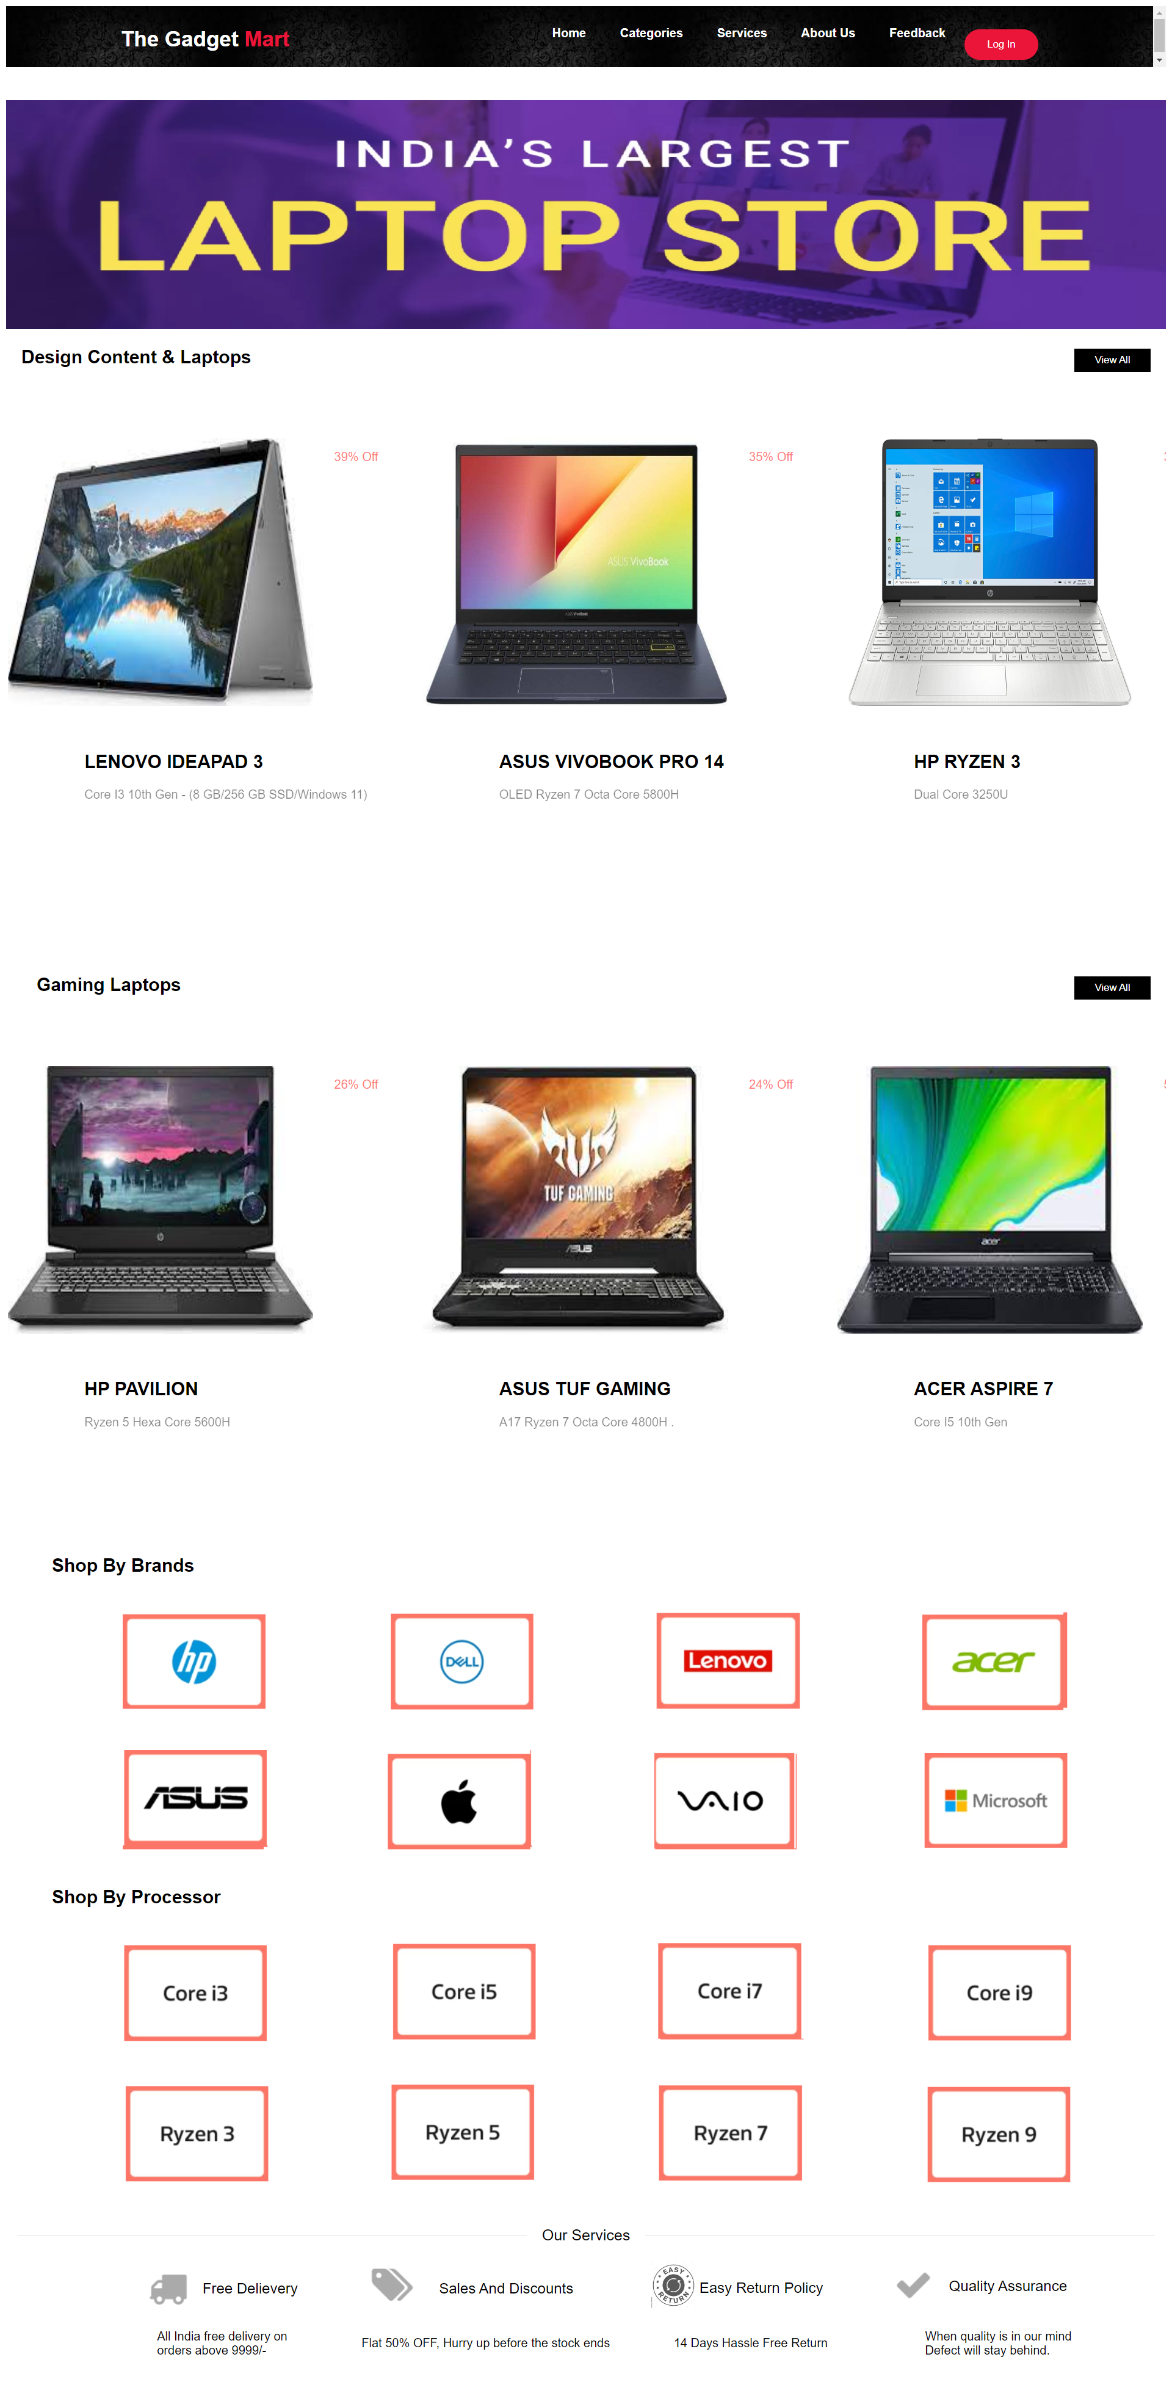
Laptop
Subcategory Page

Slide 11
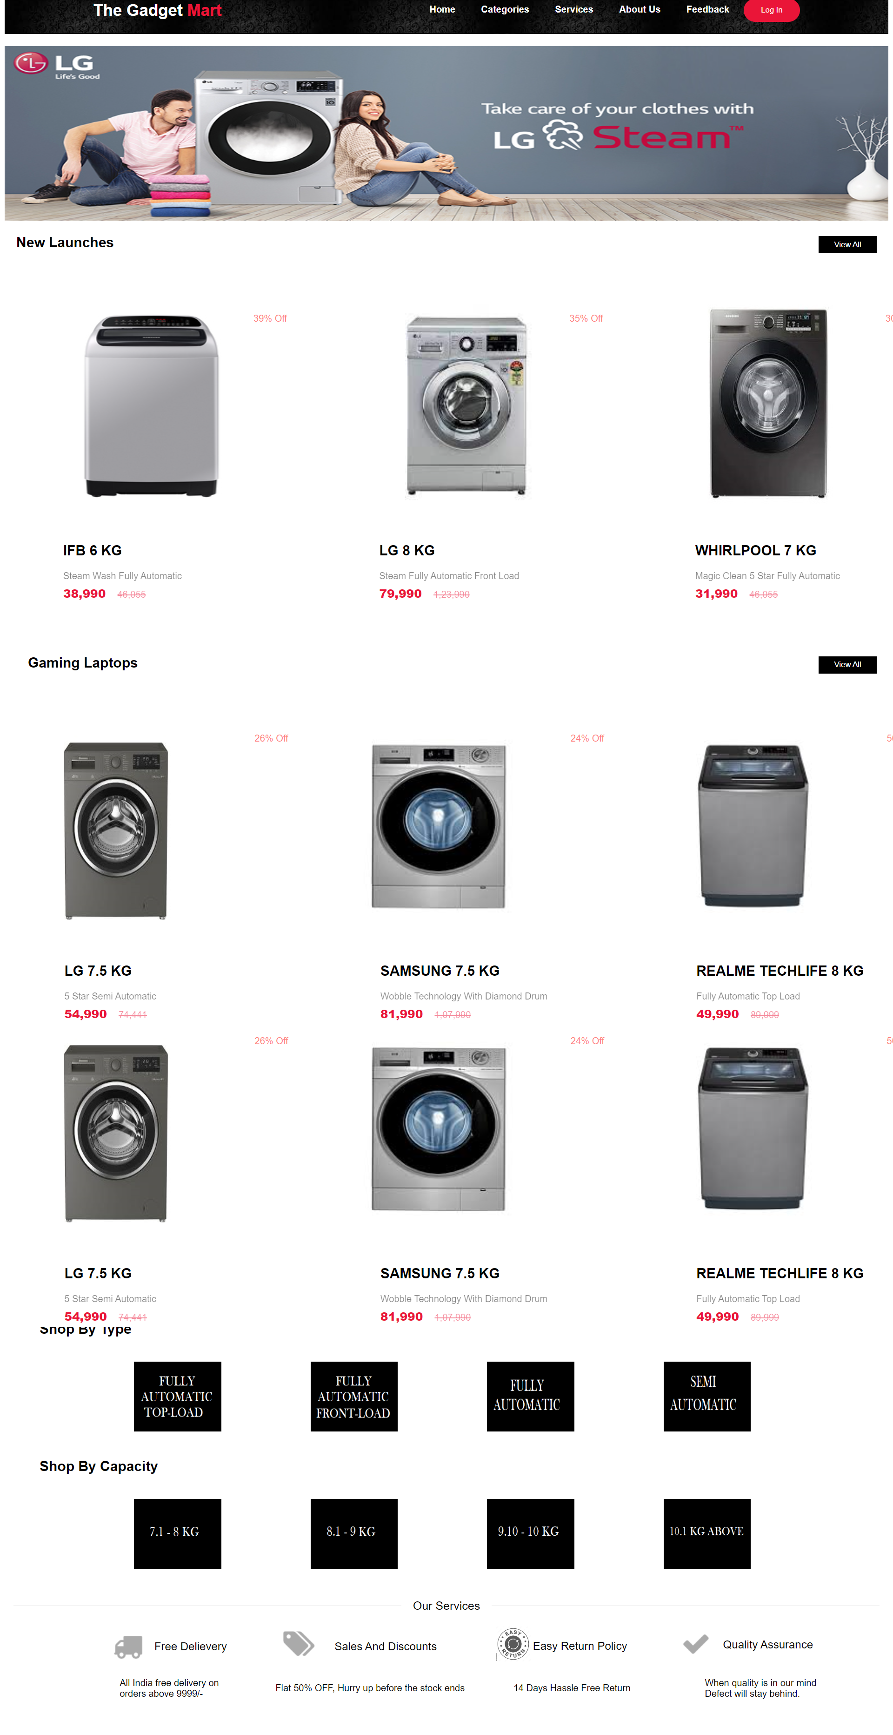
Washing Machine
Subcategory Page

Slide 12
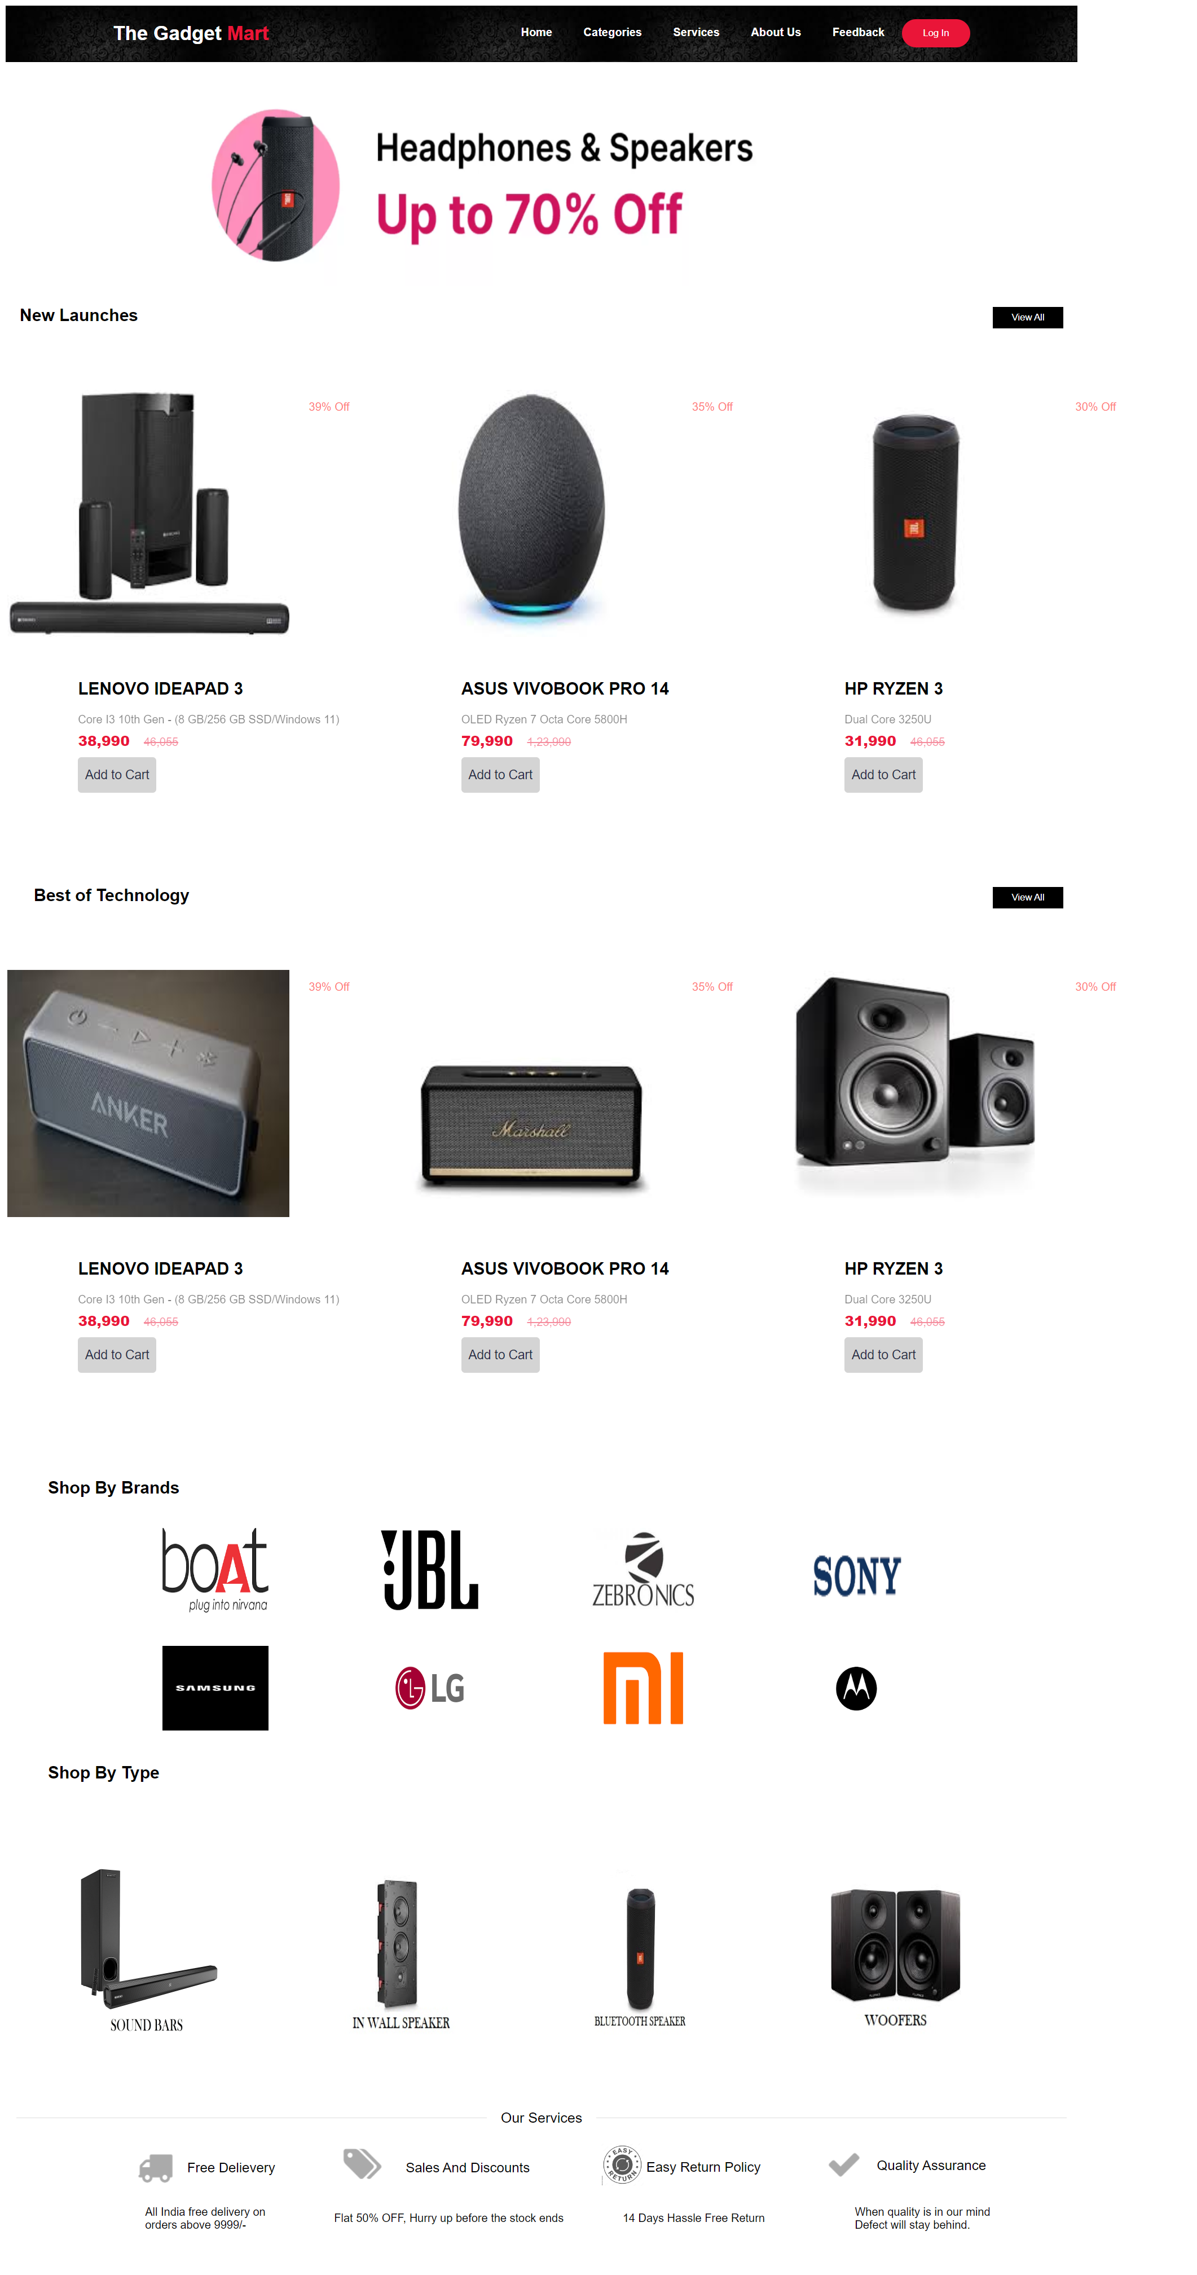
Speaker
Subcategory Page

Slide 13
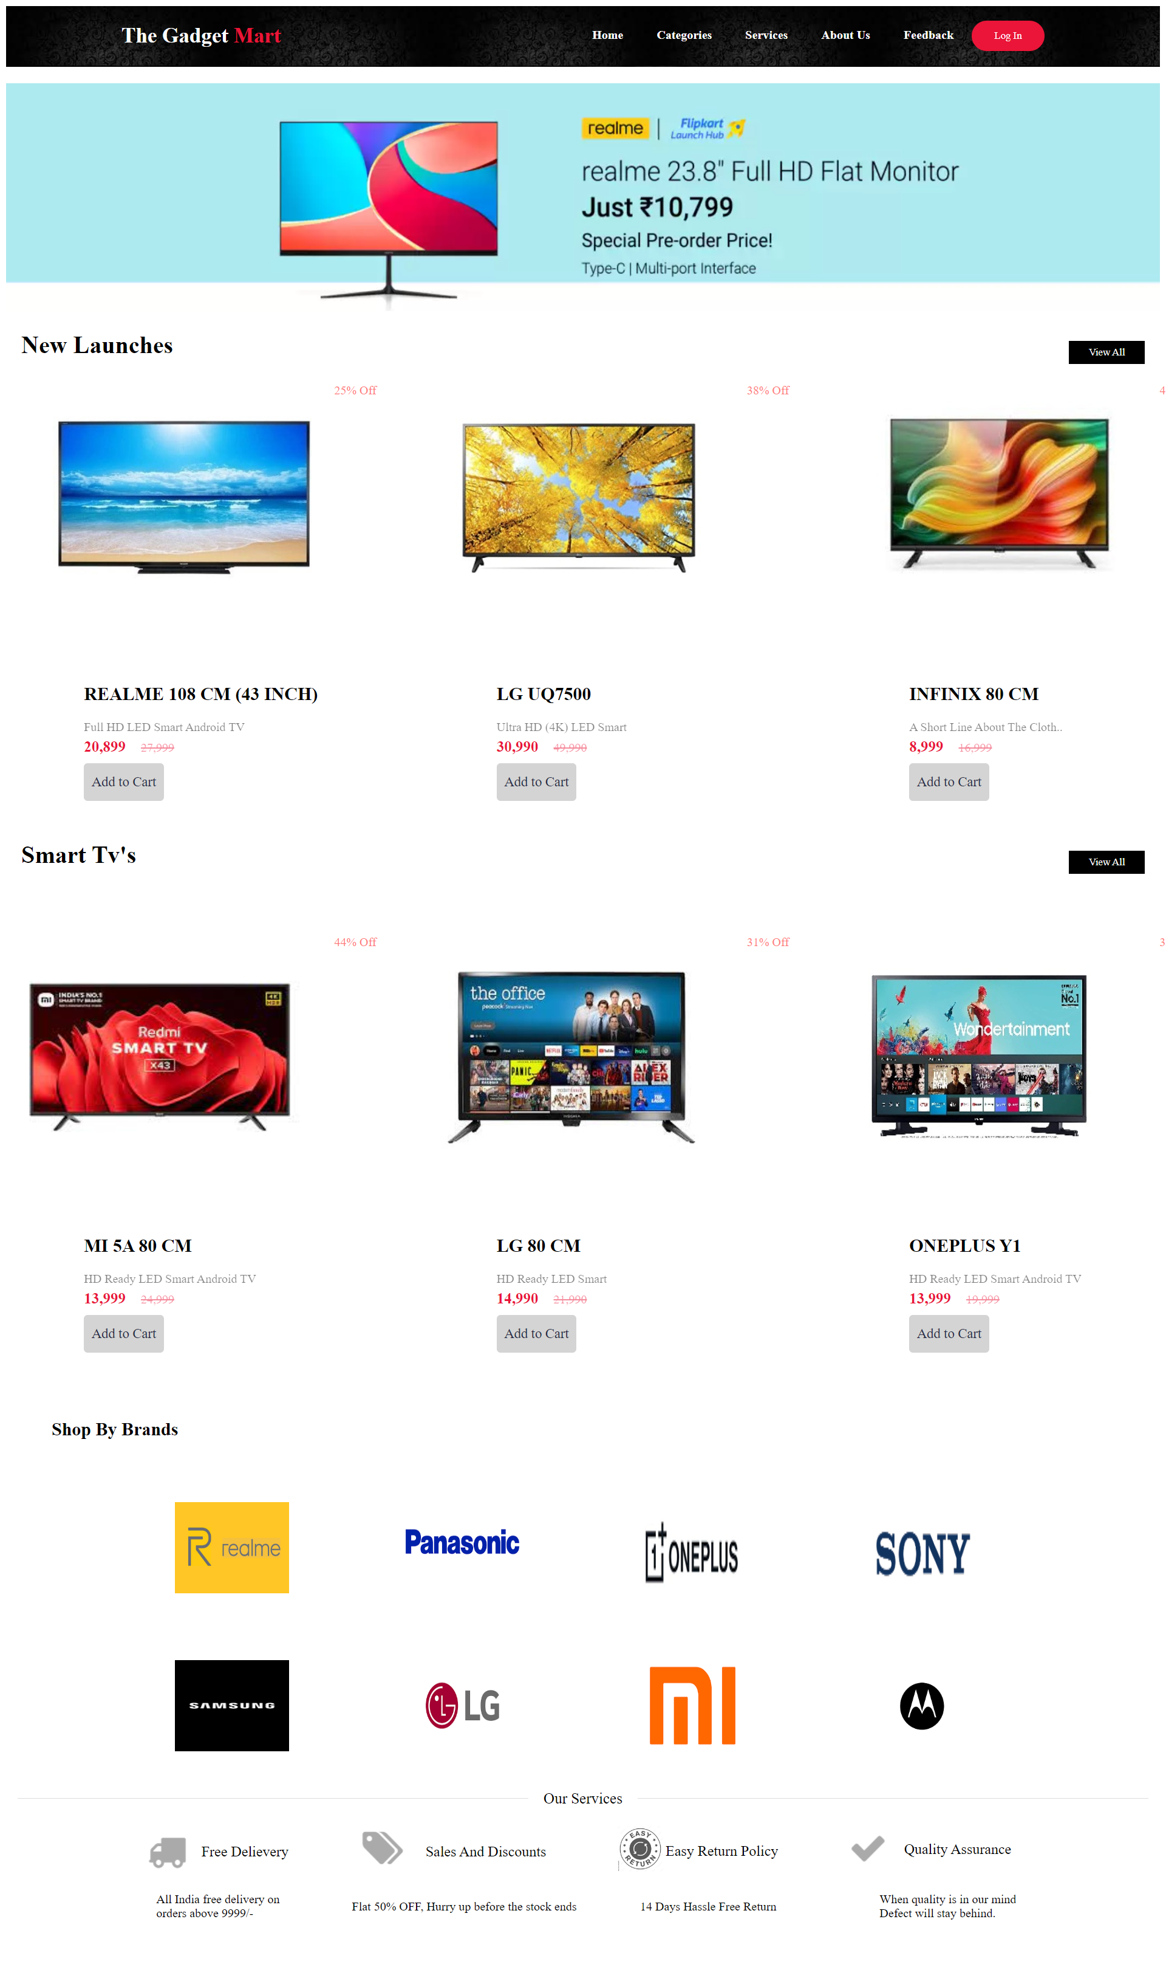
LCD
Subcategory Page

Slide 14
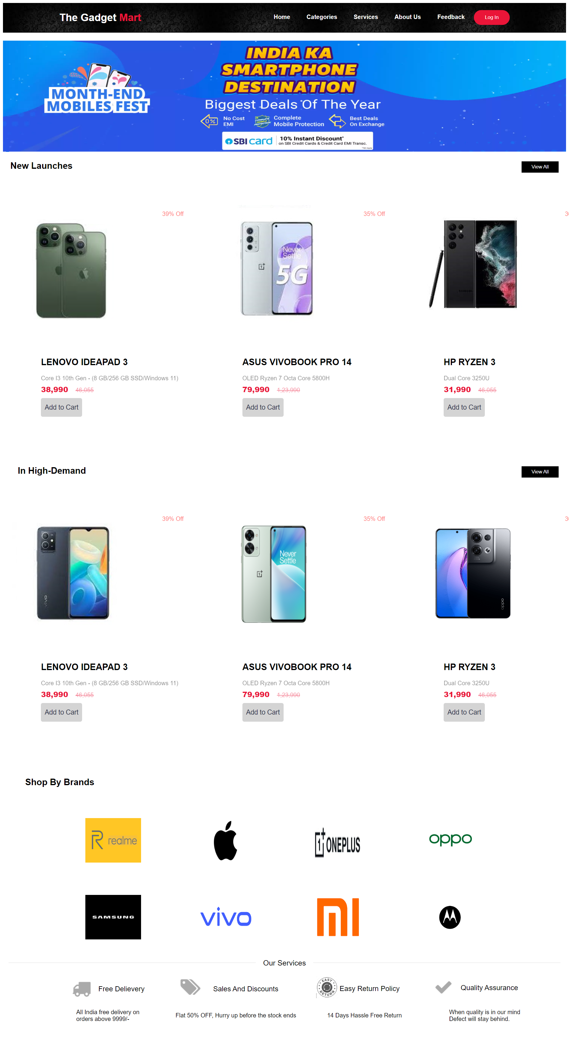
Smartphone
Subcategory Page

Slide 15
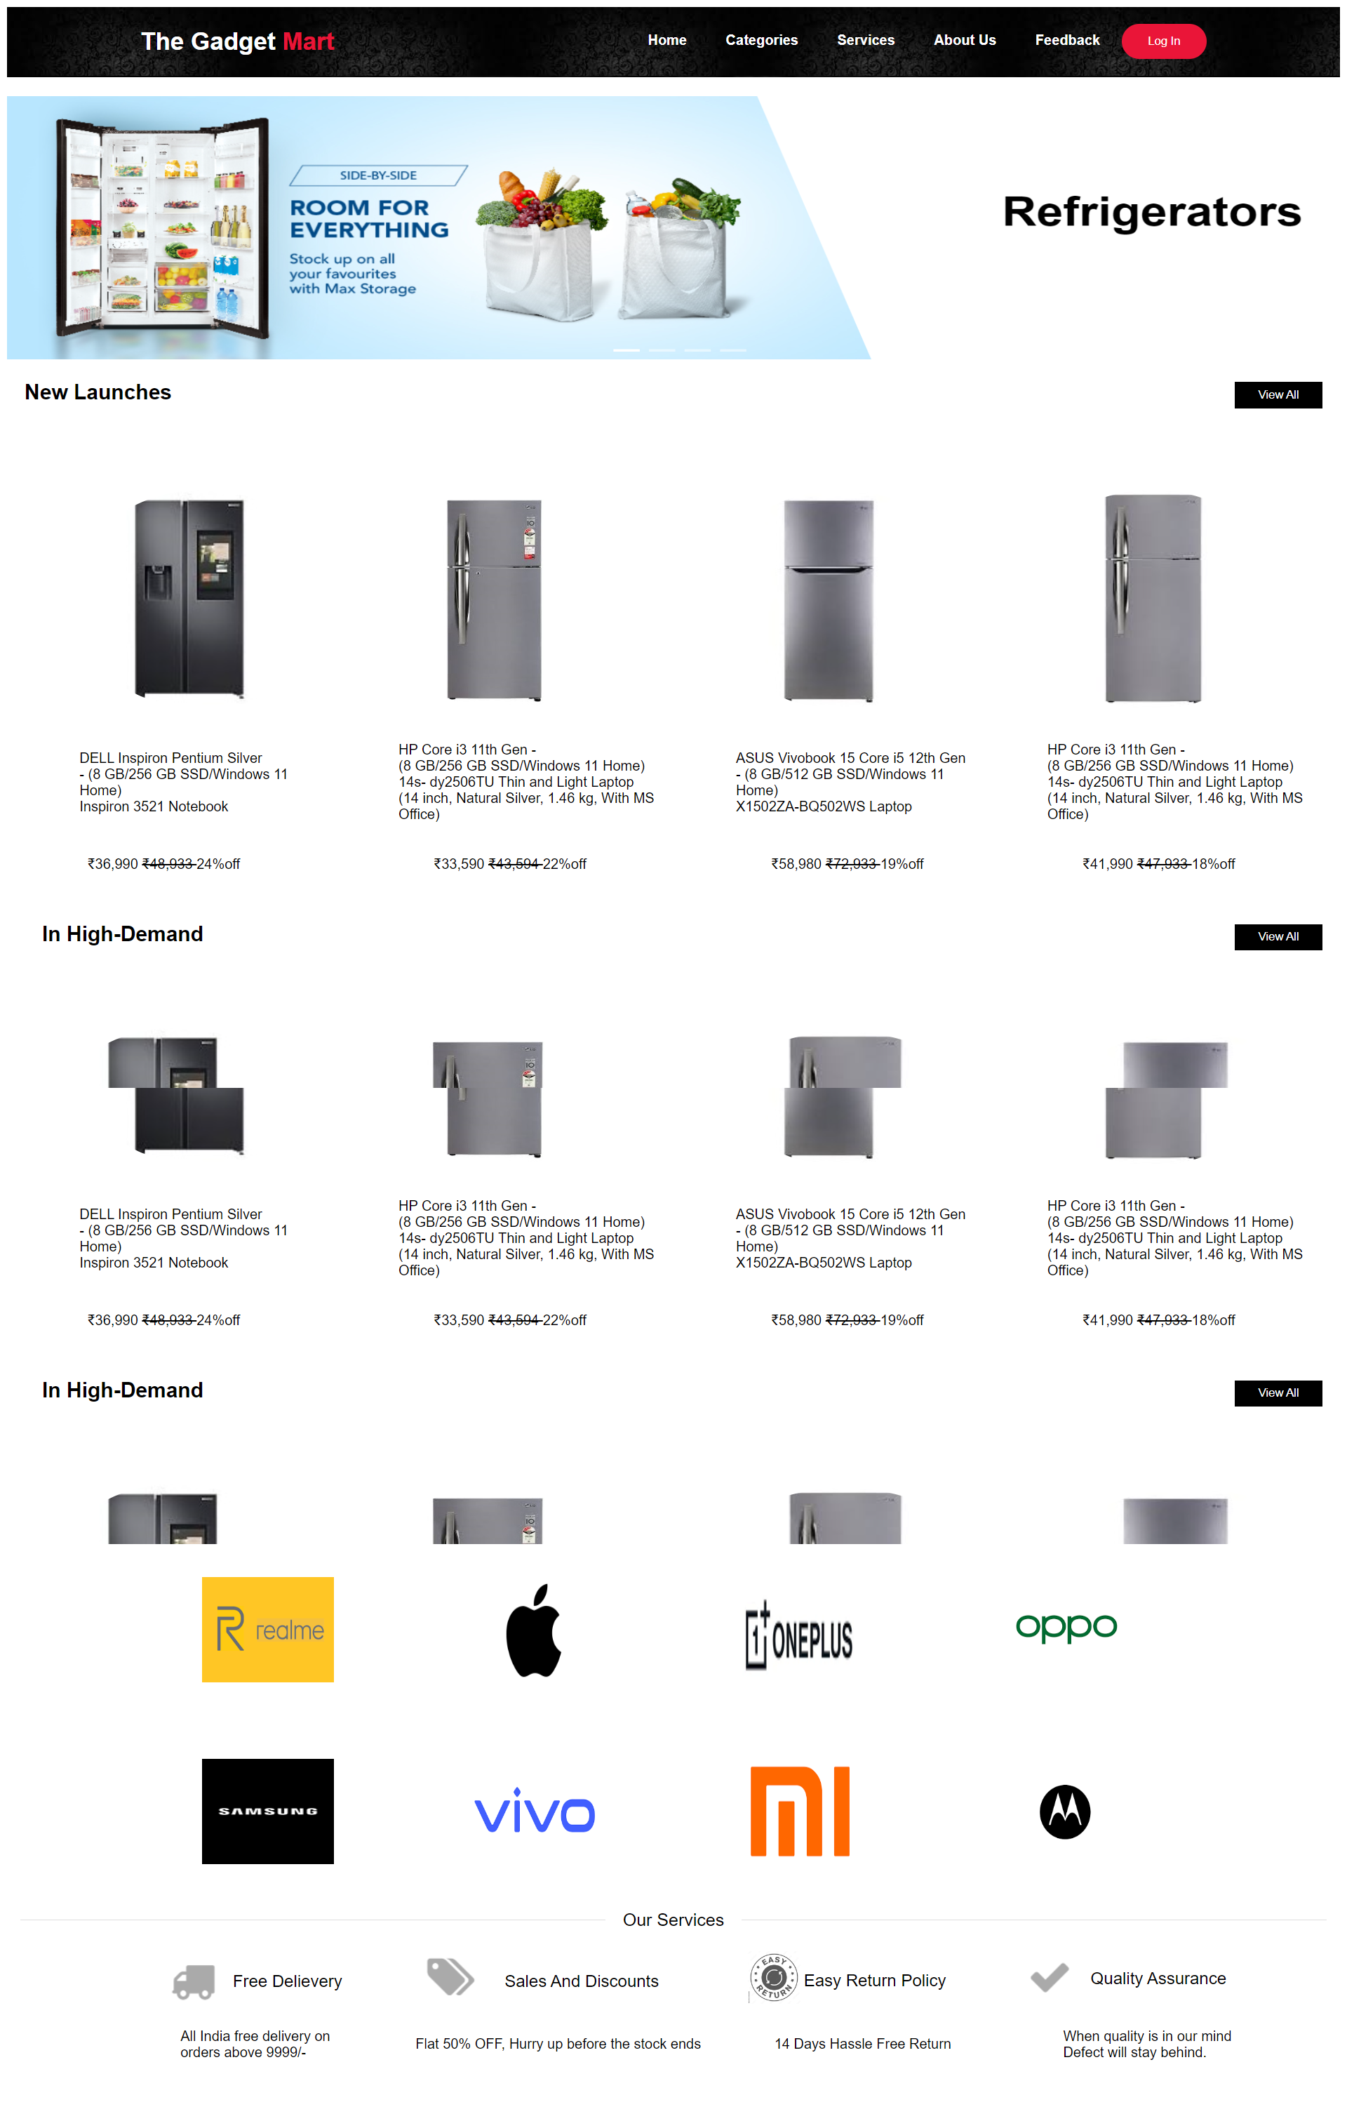
Refrigerator
Subcategory Page

Slide 16
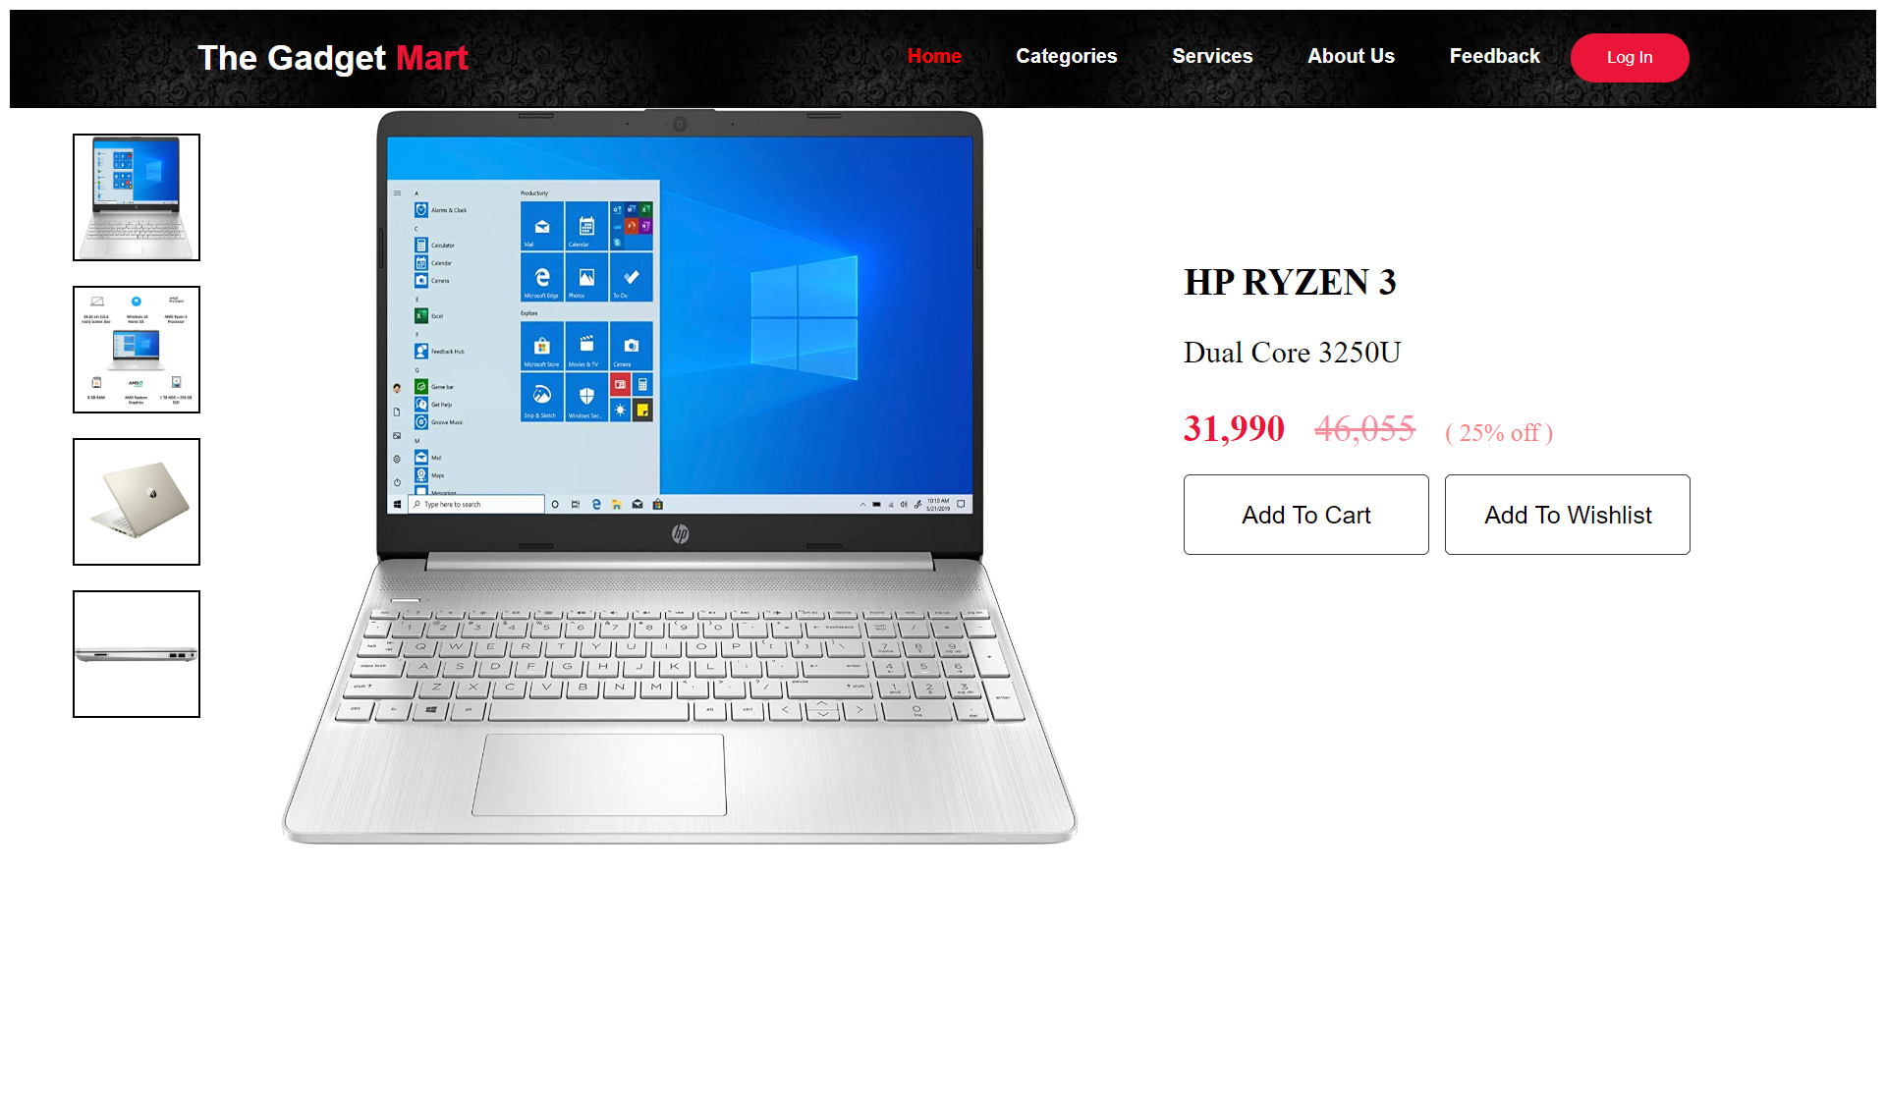

Slide 17
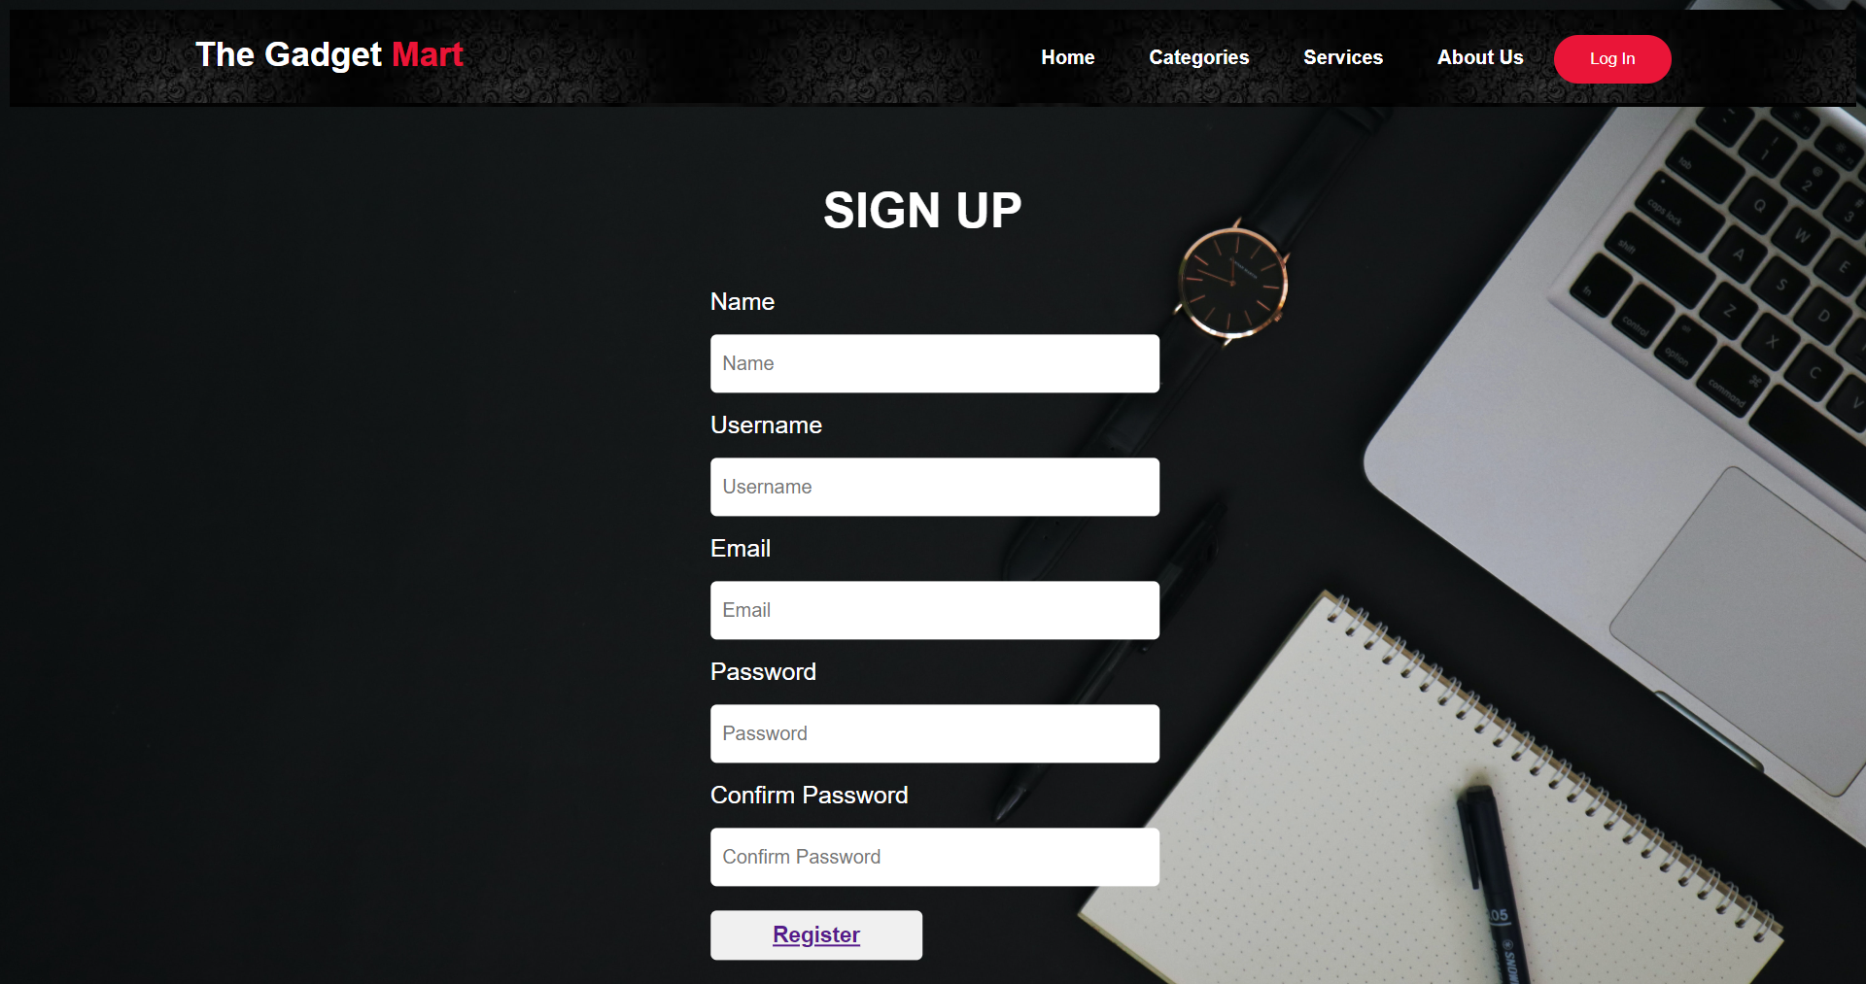

Slide 18
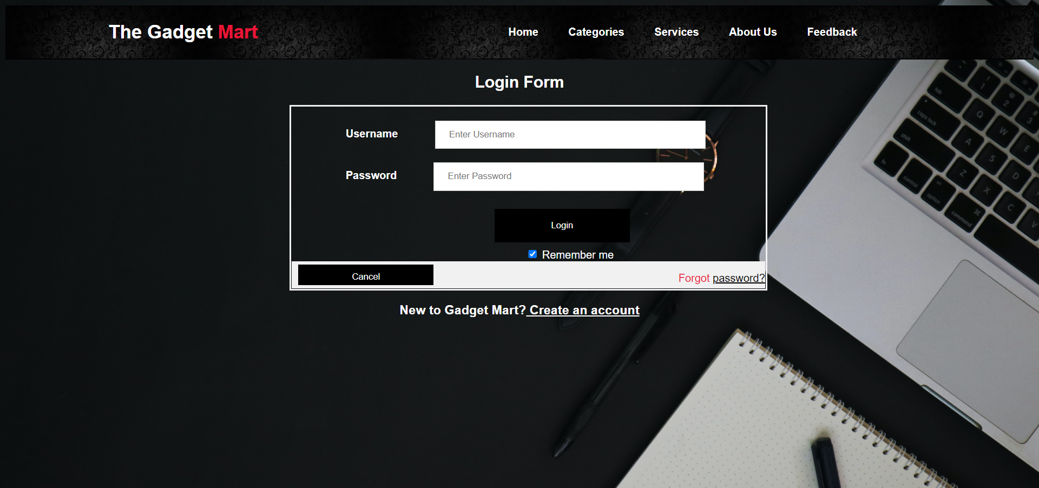

Slide 20
MORE PAGES TO BE ADDED
ABOUT US
CONTACT US
CART
Here customer can see how we started as a website
Here customer can
contact with our team for any query or complain
Customer can add
products in cart
and save them for later also

Slide 21
LANGUAGES USED
04

Slide 22



LANGUAGES USED
SOFTWARES USED
VS CODE

Slide 23
THANK YOU！

